Slide 1
Interactive Digital Photomontage
Aseem Agarwala, Mira Dontcheva, Maneesh Agrawala, Steven Drucker, Alex Colburn,
Brian Curless, David Salesin, Michael Cohen
University of Washington (US), Microsoft Research (US), 2004.
Ugo Schiapparelli, Axel Wolski
Aurelie Bugeau
17/11/2017 Advanced Methods for Image Processing

Slide 2
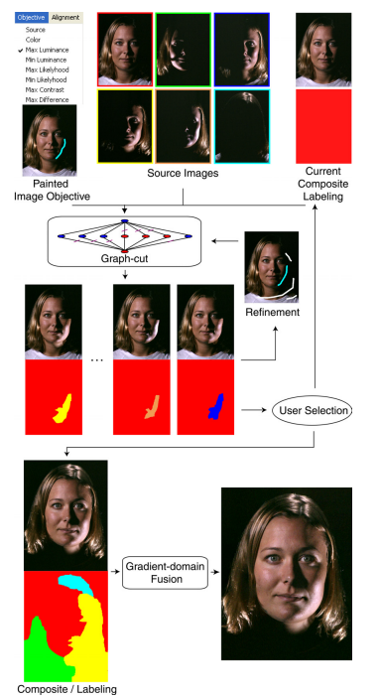
Introduction
Interactive photomontage framework
A wide variety of objectives
Algorithms using:
Graph-cut optimization
Gradient-domain fusion

Slide 3
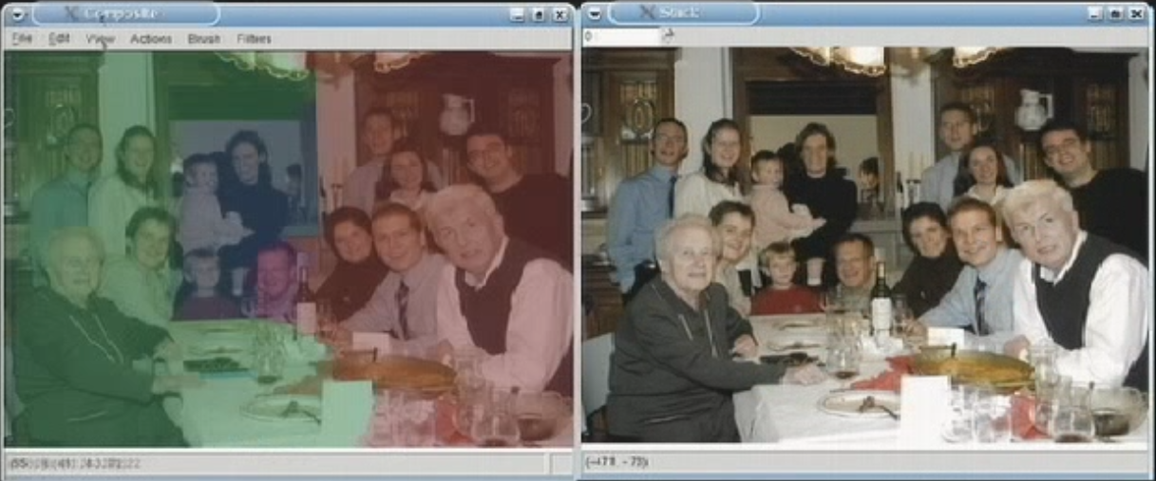
Photomontage framework presentation
Composite
Source
Current photomontage result
Adding intermediate results to the set of source images
Selection of objectives
Initial images
User can scroll through the source images
Possibility to select the part of the source image he wants

Slide 4
Objectives
Image objective can be applied globally to the entire image or locally to only a few pixels.
Designated color
Minimum/maximum :
Luminance
Contrast
Likelihood
Difference
Designated image
Seam objective is always specified globally across the entire image.
Colors
Colors & gradients
Colors & edges

Slide 5
Brushes
Single-image brush :
Use more frequently
Between the current composite and each of the source images independently
Multi-image brush :
All source images are fused together to obtain best locally and globally result.
This operation can take significant time

Slide 6
Algorithms use
Graph-cut optimization, Boykov et. al [2001]
Find the best seam
But artifacts may still exist
Gradient-domain fusion, Fattal et. al [2002]
Use color gradients rather than sources of color
Smooth out color differences between juxtaposed image regions
Use discretisation of the Poisson equation to make best-fit image

Slide 7
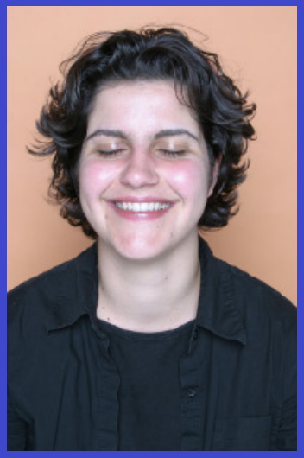
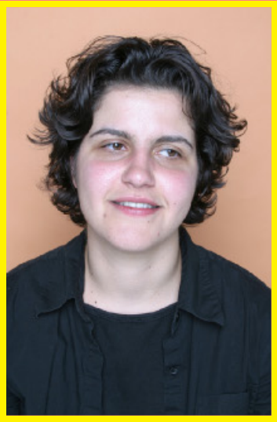
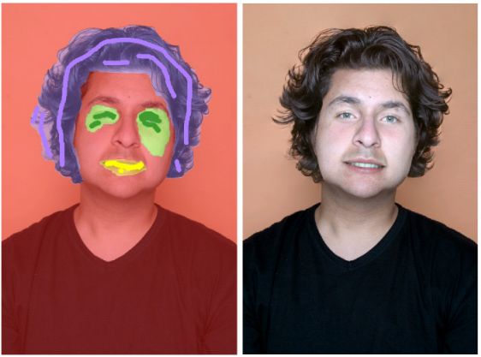
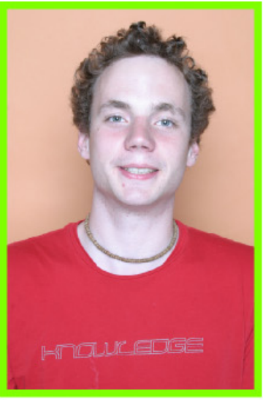
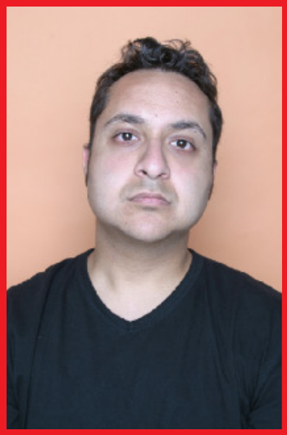
Differents applications & results
Selective Composites

Slide 8
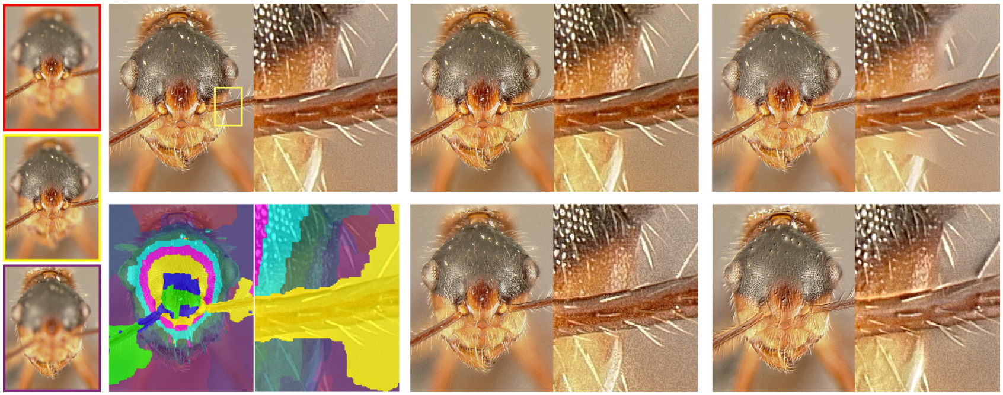
Extended depth of field

Slide 9
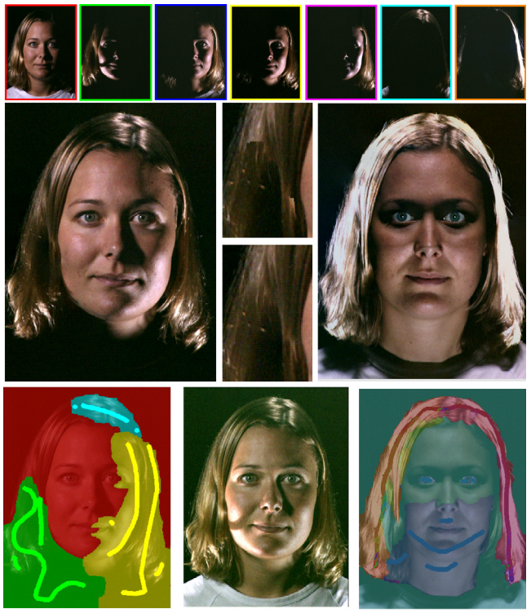
Relighting

Slide 10
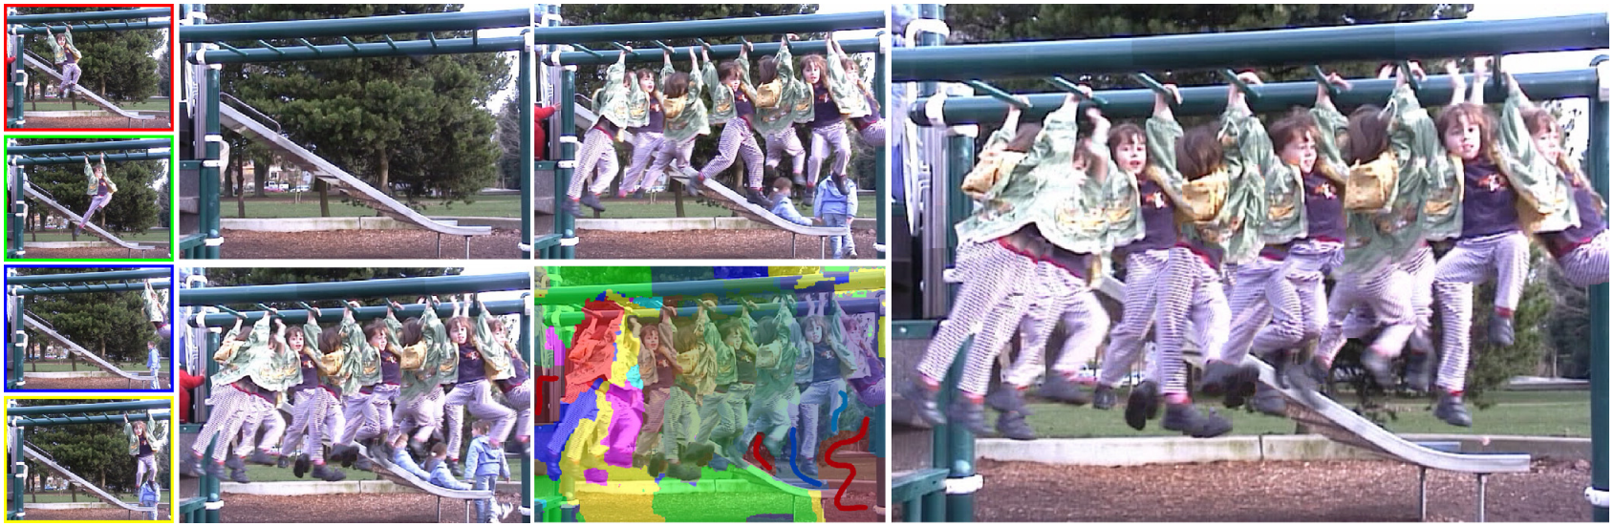
Stroboscopic visualization of movement Clean-plate production

Slide 11
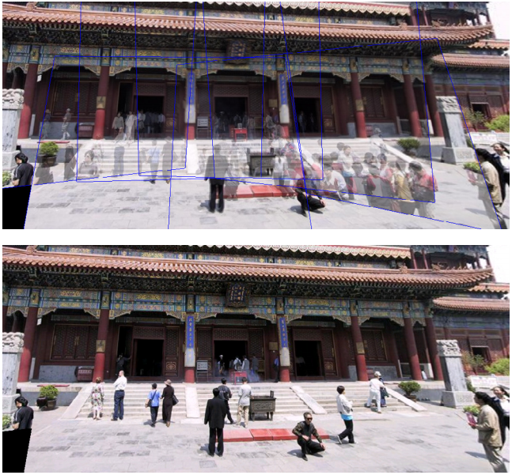
Panoramic stitching

Slide 12
Conclusions
Advantages:
Easily and quickly to use
A wide variety of applications
Drawbacks:
Need similar images
Future:
Apply this approach to other type of data (2.5D layered images, 3D volumes, …)
Many more applications could use this approach

Slide 13
References
A. Agarwala, M. Dontcheva, M. Agrawala, S. Drucker and A. Colburn, "Interactive Digital Photomontage", SIGGRAPH, 2004 http://kneecap.cs.berkeley.edu/papers/photomontage/photomontage.pdf
http://grail.cs.washington.edu/projects/photomontage/
Documentation of photomontage framework http://grail.cs.washington.edu/projects/photomontage/release/photodocs/index.html
Graph Cuts https://moodle1.u-bordeaux.fr/pluginfile.php/304243/mod_resource/content/2/GraphCuts.pdf
Y. Boykov and M.-P. Jolly, "Interactive Graph Cuts for Optimal Boundary & Region Segmentation of Objects in N-D Images", ICCV, 2001 http://www.csd.uwo.ca/~yuri/Papers/iccv01.pdf
R. Fattal, D. Lischinski and M. Werman, “Gradient domain high dynamic range compression”, SCSE, 2002 http://www.cs.huji.ac.il/~danix/hdr/hdrc.pdf
Poisson https://moodle1.u-bordeaux.fr/pluginfile.php/271243/mod_resource/content/0/Poisson.pdf

